Slide 1
The power of Data Science in EFRO-ToxFlow
Marie Corradi
Nienke Stigter
Amra Milasinovic, PhD
Johanna Louter
Rene van der Ploeg, PhD
Alyanne de Haan, PhD
Marc Teunis, PhD*
*Corresponding author
Notes:
The title refers to the fact that the process of data collection and also the analysis of experimental data in the EFRO project (at least for the HU) has heavily leaned on support from the data science team. The analysis pipeline (shiny apps) have served as go-to applications for the experimental people to base discissions on. Here I would like to provide some examples on how the two teams collaborated and present some preliminary results on the outcome of that collaboration.

Slide 2
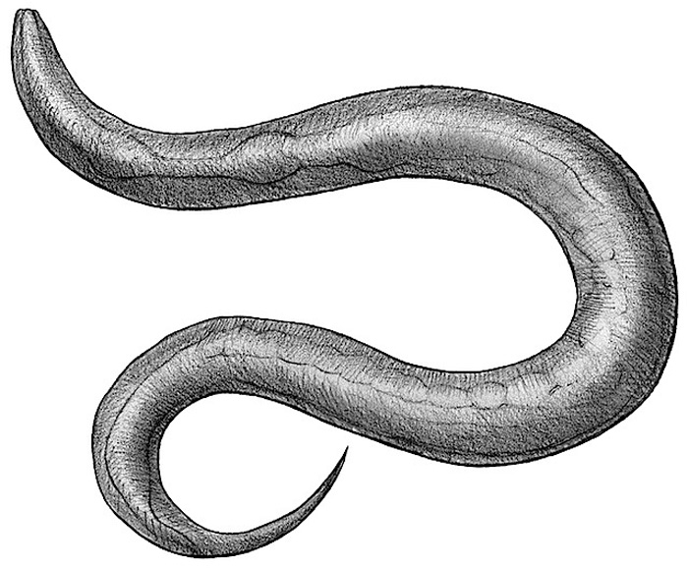
Our super team!
Data steward
Analytics Translator
C.elegans specialists
Data Scientists
Microbiology specialist
Project leader
Statistics specialist
Wet-lab specialist
DevOps engineer
Notes:
Similarly to needing various expertises in the lab,data analysis is not only a data analyst, More roles are needed : data steward to ensure proper data managements is in place, devops to ensure proper tools are available, data. scientists and statisticians for the analysis. Data analysis should not be an afterthought but integrated to the process.
What is key in a project that involves the collection of large volumes of data and where data integration and data science activities are foreseen is that the analytics team and the wet lab team are brought together. Because of the nature of the activities of the two groups this is not so easy. It helps if someone can bridge the communication between the two groups as an Analytics Translator. This translator is able to translate requirements from the wet-lab team to technical requirements and implementations delivered by the data science team. The Analytics Translator and the Project Leader should also be in close connection to ensure that the right things are delivered in the project.
It worked out well. I do not know if this is optimal. We did not ‘experiment’ on this. It is just an illustration on how it could work in practice. I would say it is an important lesson to assign these roles explicitly in any follow-up project

Slide 3
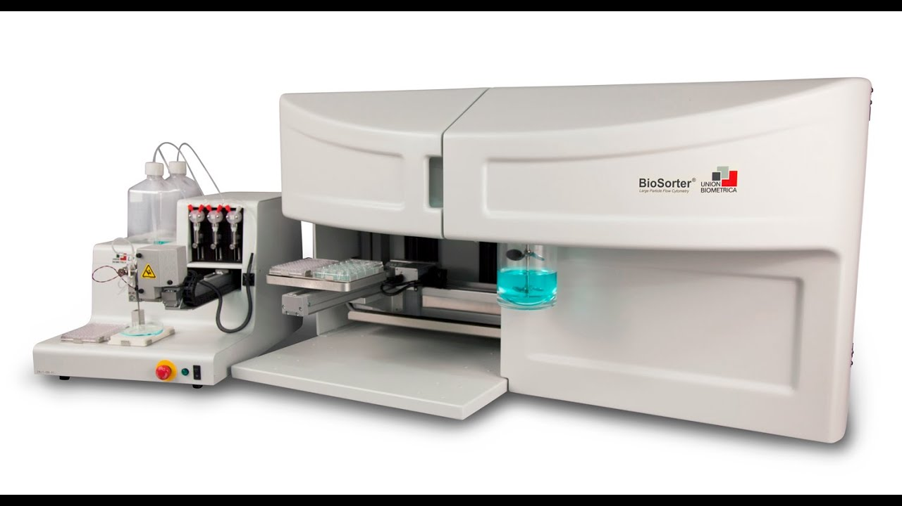
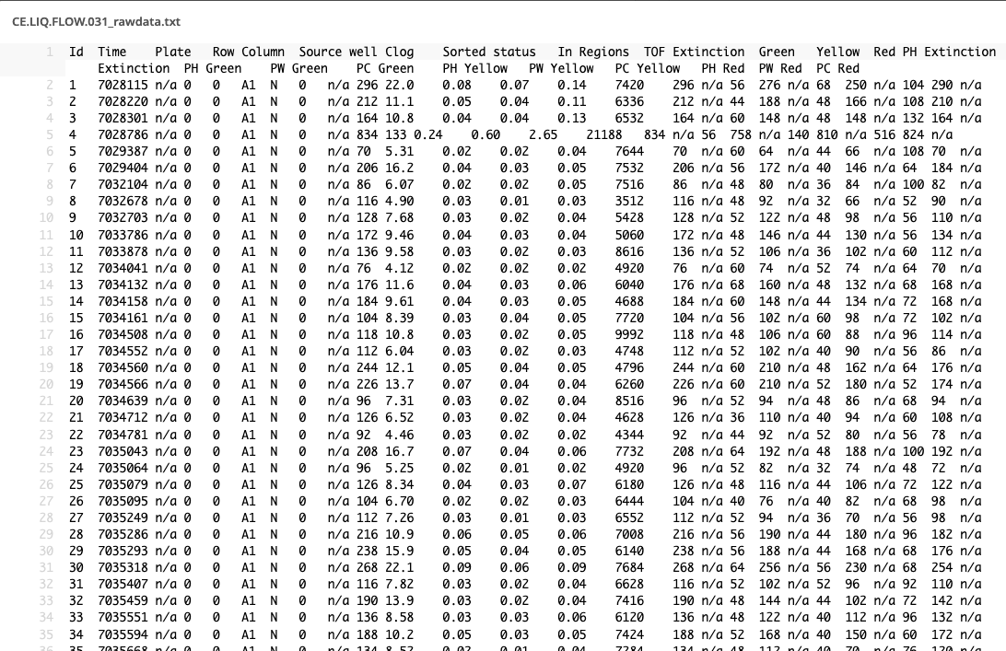
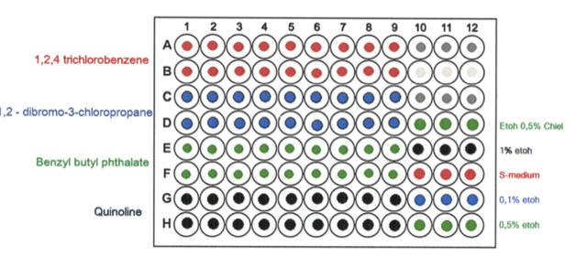
Exposure experiments with C.elegans [Biosorter]
Notes:
The work I will present today involves experimental work preformed on the round worm C.elegans, that Marjoleim earlier today also talked about. In the experiments that I will show, C.elegans was exposed to ranging concentrations of different toxic and non-toxic compounds. The effects of these compounds on the number (and size) of the nematodes was assessed using a high troughput system called the biosorter. This device can count and assess a number of characteristics of nematodes in suspension, using a technology that is alike a flow cytometer. This method was optimized for measuring C.elegans.

Slide 4
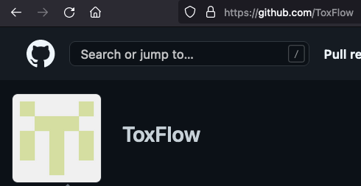
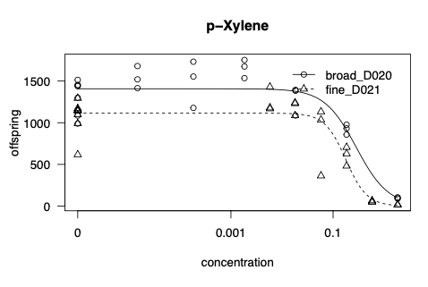
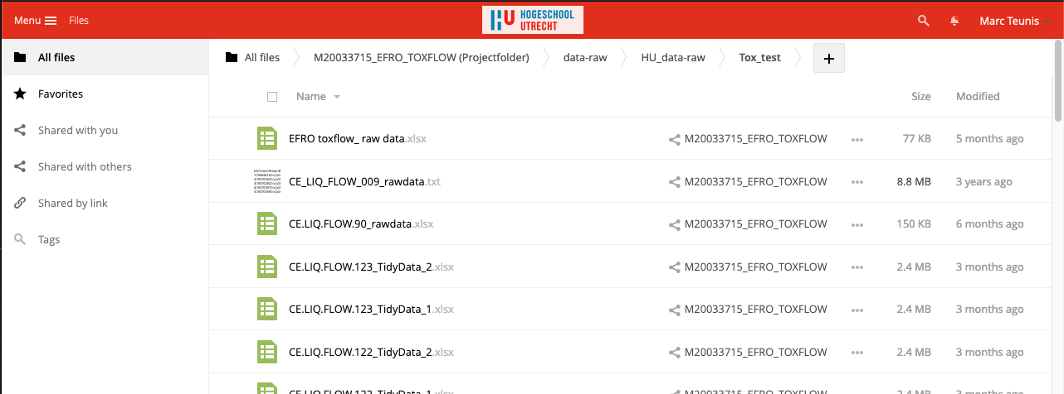
Collaboration on the data
Notes:
To ensure that the wet-lab and the data science teams could effectively work together, we established this workflow. Experimental data generated by the wet lab team was recorded in standardized templates in Excel. Templates ensure
Standardizing data formatting
Machine readability
Interoperability
FAIR-ification
Analysis of data with more ease and structure
Reproducible Research
The files were stored on SURF ResearchDrive for back up and long-term storage.
The data science team could access the data through the storage being available in their development environment Rstudio. This environment was used in the cloud on SURF ResearchCloud. Having access to the data directly in the environment you program in prevents having multiple copies of files and ensures working with the right datasets. There is no need to email files back and forth. Everybody has access to the same and latest data.
Code generated by the Data Science was stored on Github to ensure reproducibility and backup. Applications such as the Shiny app, that I will demonstrate in a moment, were hosted on a server. This means that the wet lab team could access the app at any time and use the app to explore and analyze the data. Let’s see how this works in practice.

Slide 5
Templates
Standardizing data formatting
Machine readability
Interoperability
FAIR-ification
Analysis of data with more ease and structure
Reproducible Research

Slide 6
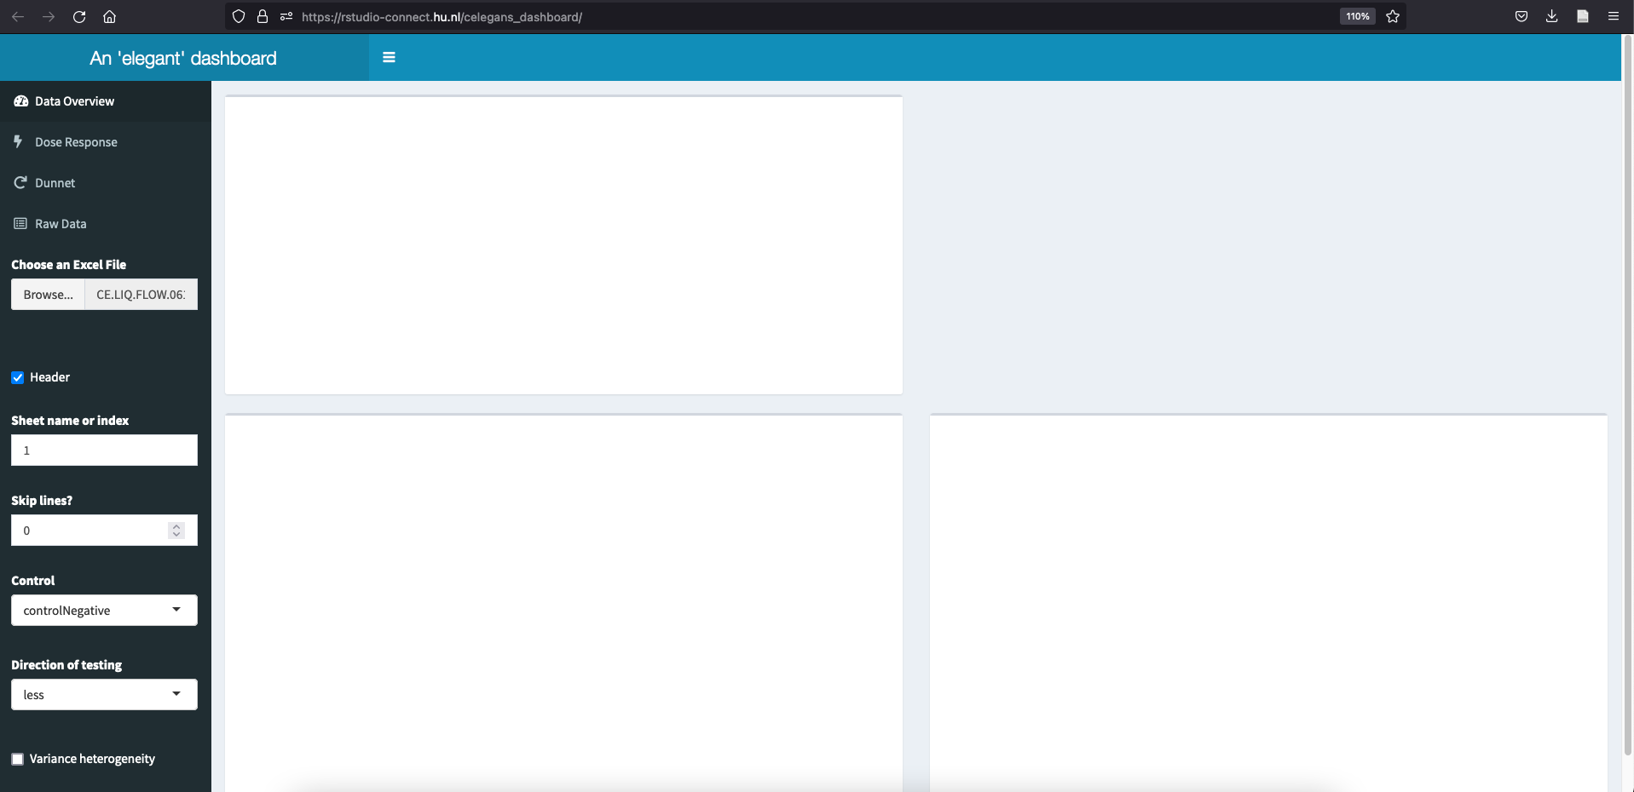
Online R {shiny} dashboard
Notes:
Show the steps in dashboard according the screenshots
Go to app
Upload the data
Determine the setting for the controls, on the bases of figure on all the data
Go to dose effect curve to see if there is an effect of increasing concentrations: is the ID50 reached?
Go to Dunnett, determine setting for “unequal variances” based on top panel
Perform Dunnett, determine minimal toxic conc. Based on 95% conf. interval

Slide 7
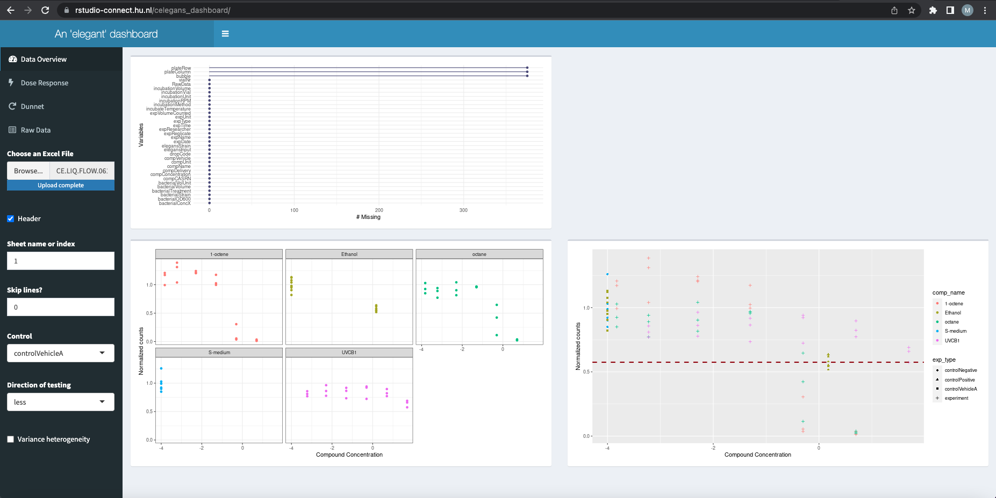
See ‘all’ data, check control settings
Notes:
Show the steps in dashboard according the screenshots
Go to app
Upload the data
Determine the setting for the controls, on the bases of figure on all the data
Go to dose effect curve to see if there is an effect of increasing concentrations: is the ID50 reached?
Go to Dunnett, determine setting for “unequal variances” based on top panel
Perform Dunnett, determine minimal toxic conc. Based on 95% conf. interval
the metadata of the experiments describes the control used in the experiment (which medium dilutions are made with or S-medium). In both cases this is ‘ControlVehicleA’, which is the medium in which the dilutions are made (e.g. ethanol). Negative control is in S-medium by default.

Slide 8
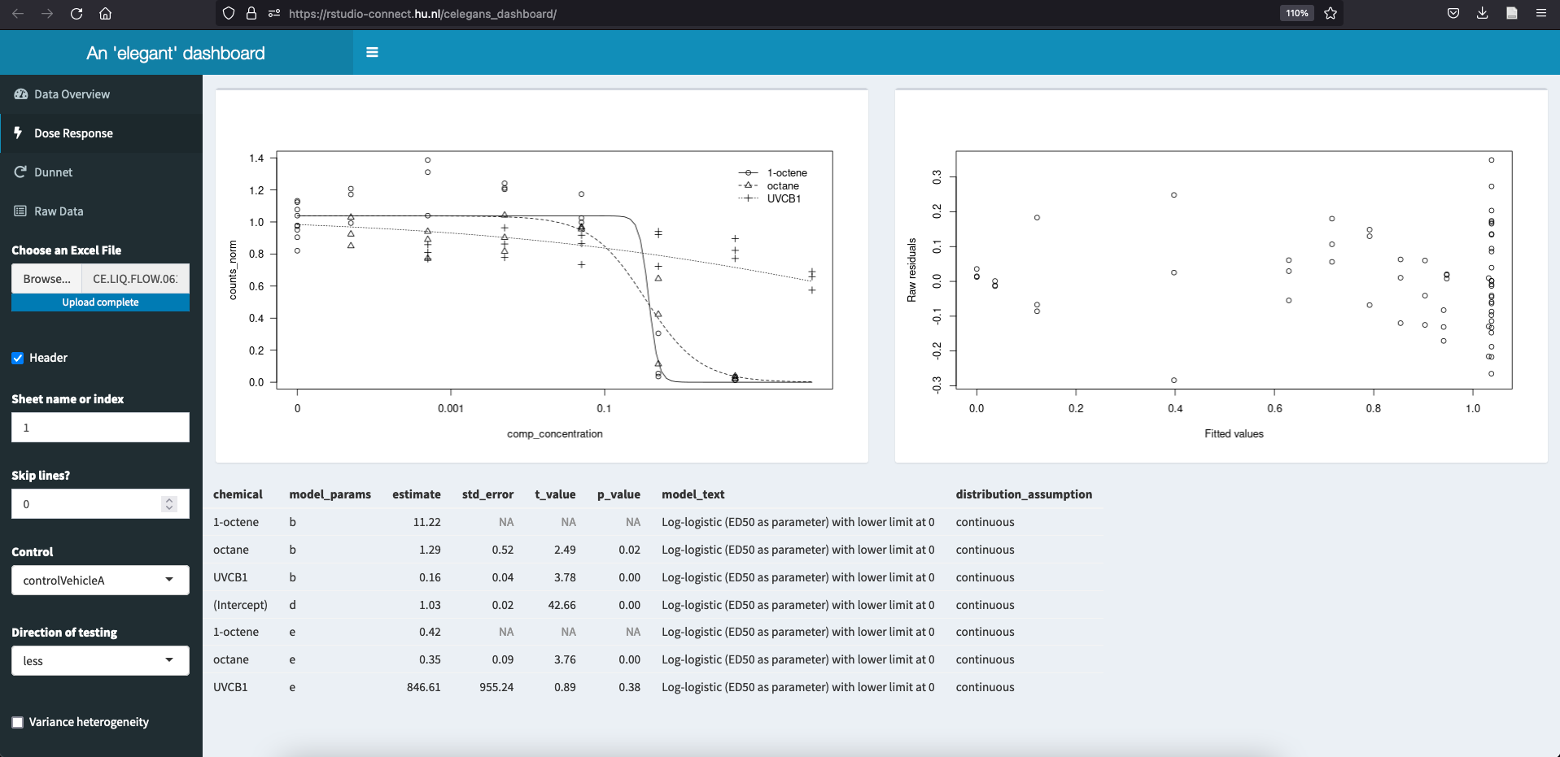
Inspect Dose Effect curves
Notes:
Show the steps in dashboard according the screenshots
Go to app
Upload the data
Determine the setting for the controls, on the bases of figure on all the data
Go to dose effect curve to see if there is an effect of increasing concentrations: is the ID50 reached?
Go to Dunnett, determine setting for “unequal variances” based on top panel
Perform Dunnett, determine minimal toxic conc. Based on 95% conf. interval
Model residuals: to check if model is fitting well

Slide 9
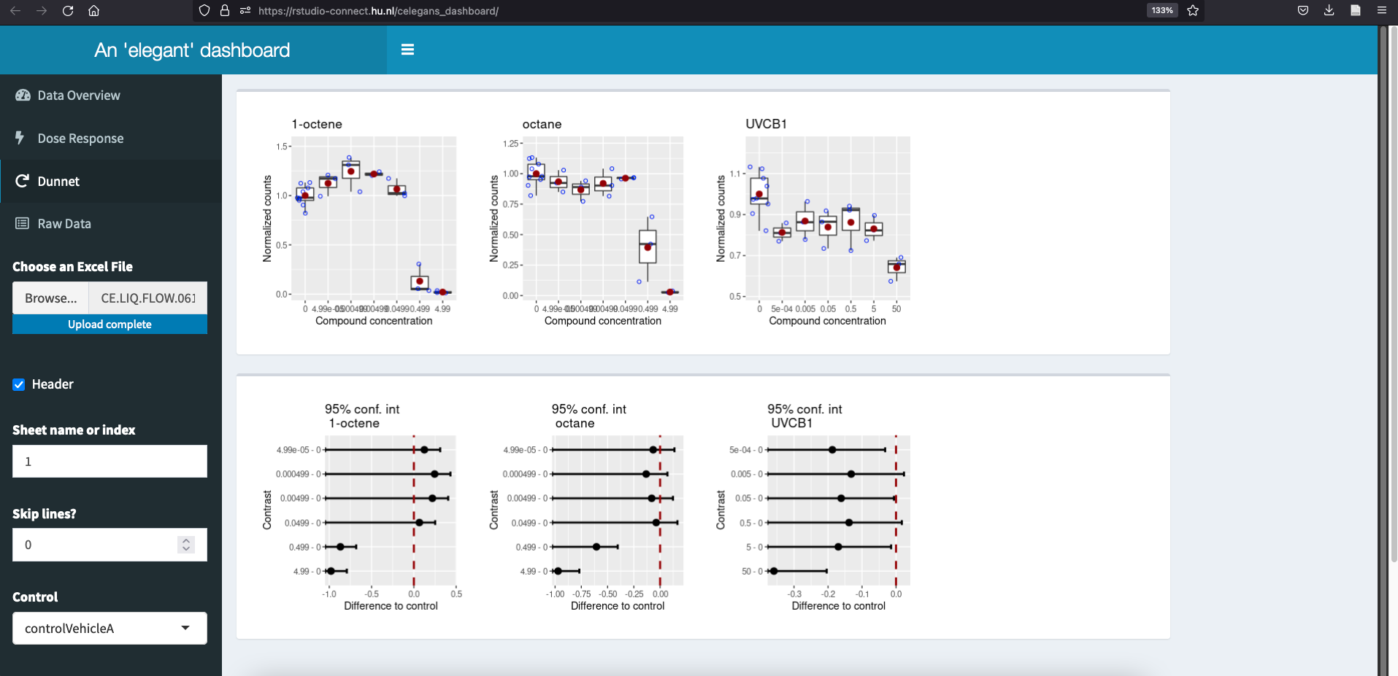
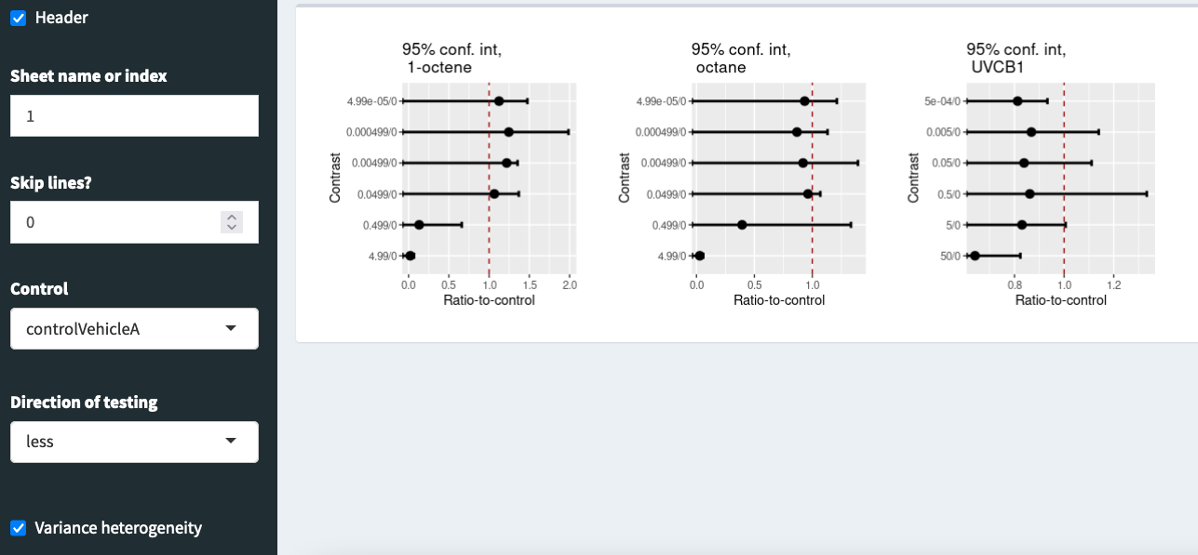
Perform Dunnett, with/without equal variance
Notes:
Show the steps in dashboard according the screenshots
Go to app
Upload the data
Determine the setting for the controls, on the bases of figure on all the data
Go to dose effect curve to see if there is an effect of increasing concentrations: is the ID50 reached?
Go to Dunnett, determine setting for “unequal variances” based on top panel
Perform Dunnett, determine minimal toxic conc. Based on 95% conf. interval
Dunnetts test allows you to compare a number of treatments with a single control (multiple comparison procedure)
Go to Dunnett, determine setting for “unequal variances” based on top panel: if boxplots show wildly different variances, check “variance heterogeneity” (right side)
you would need to do a formal check: one of the reasons why we are redoing the analysis in full.
You could perfom a Levene’s Test on the data for checking heteroscredasticity. This tool is meant for a quick exploratory check on the results of the performed experiment.
the complete 95% conf interval should be below, or above the dotted line, so for UVCB1, I would conclude that the two highest conc. Are significantly inhibiting. Under the assumption that we see a dose dependent decrease, the others are not inhibitory, but there is some (biological) variability causing a sway...

Slide 10
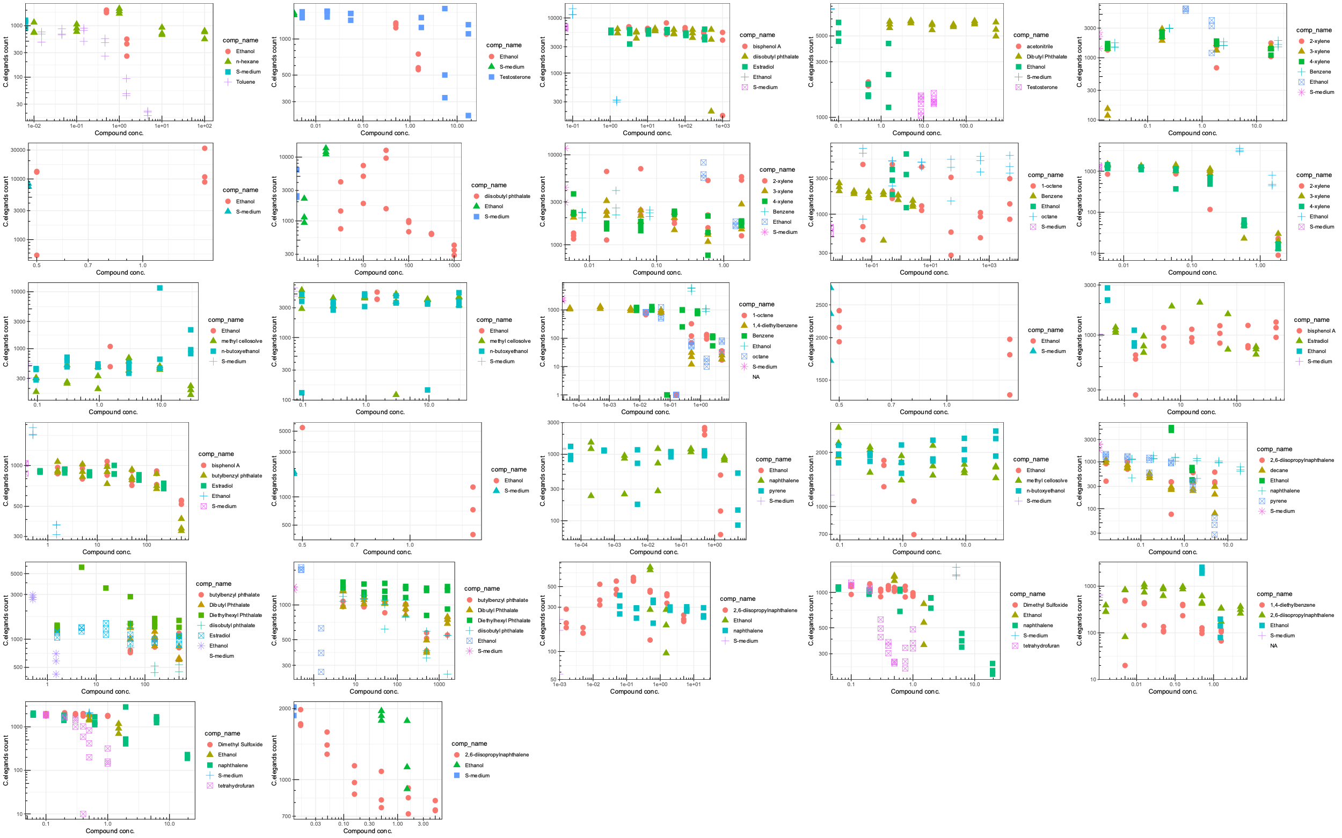
27 unique experiments with 26 test compounds
Notes:
When all experiments with the biosorter were performed we started with the aggregation of the data. This yielded a dataseyt with > 2 M rows and > 60 variables.
We are now in the process of reanalyzing those experiments to perform Dose-Response analyses for all compounds and rank them according toxicity.

Slide 11
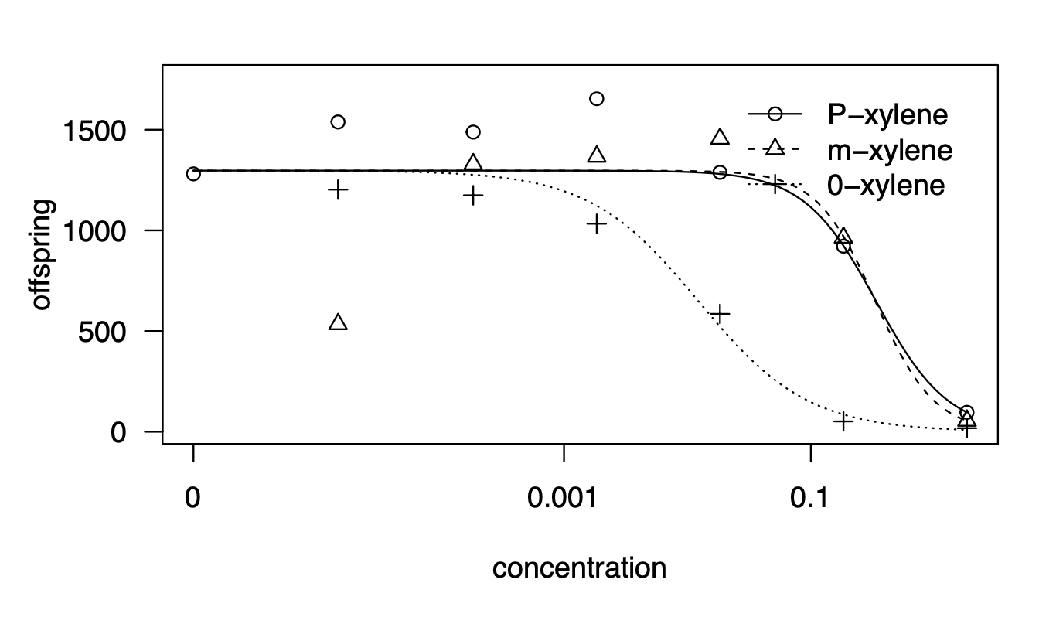
Dose response curves, per experiment

Slide 12
Next steps
Aggregate data from manual count experiments
Normalize data
Combine all data
Perform probabilistic determination of EC50 values
Rank compounds, based on average EC50
Compare ranking with existing tox data (e.g. EPA Dashboard / ChEMBL)
Publish findings
Publish full annotated dataset in a public repository (probably https://www.ebi.ac.uk/biostudies/ )
Notes:
The next steps, that are currently under way are that we will also include the data that was collected from experiments where the Biosorter was not used and nematodes were counted manually.
After normalizing the data (bring responses for all compounds and experiments to scale 0 – 1), we will enrich the dataset with tox data from existing databases such as those mentioned on the slide. We aill also employ and investigate different ways of establishing EC50 values, leading to more probabilistic estimates, compared to the classical point estimates.
We can then rank the compounds based on the experimental data and compare that ranking to the ranking obtained from database mining. This will enable defining an initial applicability domain for using C.elegans as a model system for toxicology .
Biggest take-away from the final slides is that the work continues and that we are working toward sharing everything in a well-documented and open way.

Slide 13
Acknowledgements
Innovative Testing [Data Science] Alyanne de Haan Rene van der Ploeg Marie Corradi
Innovative Testing [Wet Lab] Nienke Stigter Johanna Louter Amra Milasinovic
HU [Data Steward] Tineke van der Meer
Vivaltes Marjolein Wildwater
Jesus Arellano
Students Anna van der Vaart (wet lab)
Ireen Scheffers (wet lab)
Kasja Claessens (wet lab)
Meike Hulleman (wet lab)
Noah Pols (wet lab)
Ellis Herder (wet lab)
Sergio Reijnders (wet lab)
Menno de Jong (data science)
Stijn van den Broek (data science)
Softbank’s Pepper Robot

